Slide 1
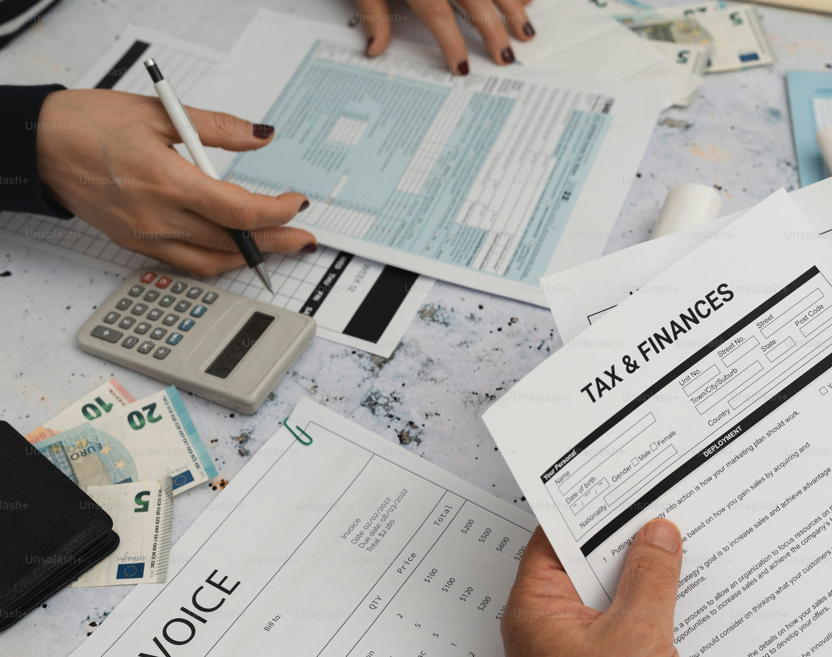
TAX
ESTIMATOR
APP

Slide 2
Problem fit
In Switzerland, it is challenging to estimate the yearly amount of taxes, especially as a first year enteree in the labor market.
To solve this problem, we will develop an app, that estimates your taxes based on several factors, in accordance to Swiss tax law.

Slide 3
Solution fit
Ca
Solution: an extended tax calculator that will assist an average Swiss citizen in estimating his/her yearly taxes.
It will include several deductions, income tax, simplified wealth tax, married/single status, canton of residence.

Slide 4
Main Feature: Tax Calculator
Gross Income
Social deductions
Optional deductions
Netto Salary
User can manually choose a category and enter the deduction
AHV
ALV
NBU
BVG/LPP
Graph visualization: tax/income ratio
pie chart visualization: different categories of tax
Marital Status
Income Tax
Wealth Tax
Divides the users into two separate groups due to combined taxation
Income tax calculated
Partial / simplified categories

Slide 5
Data Input
Swiss Tax API Providers (e.g. swiss-tax-api )
Swiss Federal Tax Administration Datasets
Individual User Input

Slide 6
Solution fit
Ca
Tax law is complex, therefore several implications and limitations will have to apply.
The app will provide only an estimation, not a defined or accurate tax amount
The app will not include taxation implications for foreigners or people commuting to work from a neighbouring country for simplicity.
The app will not be able to include all existing types of tax and will include some averaged out variables in some cases of tax calculation (e.g. municipal tax)
Wealth tax is complex, therefore there is a possibility of removing it from the project.

Slide 7
Machine Learning Approach
Two machine learning ideas have been developed. One of them will be implicated into the project.
Personalised deduction recomendations
Quantile regression estimation

Slide 8
Personalised deduction recommendations
Rule-based systems at simple logic:
If married → double child deduction
If 3a contribution > CHF 7 056 → cap at limit
But they can’t learn patterns like:
High-income families benefit more from 3a + childcare than commuting deductions
Singles in Zürich often miss insurance premium deductions
→ ML learns from real data to predict & prioritize deductions automatically

Slide 9
Personalised deduction recommendations
Goal:
Predict how valuable each deduction will be for a given user profile — in numbers (e.g., expected tax saving in CHF).
Intuition:
Feed the model many examples of taxpayers and how much they saved through each deduction.
The model learns the relationships between the input features and the tax savings.

Slide 10
Personalised deduction recommendations
The model learns patterns like:
Higher income → larger possible tax saving from 3a contributions.
More children → higher childcare deductions.
Canton Zurich (ZH) vs Geneva (GE) → different deduction effects due to cantonal tax rates.
Married couples → combined income affects deduction ceilings.
Goal:
Predict how valuable each deduction will be for a given user profile in numbers

Slide 11
Personalised deduction recommendations
How it learns (mathematically simplified):
Gradient boosting builds many small decision trees that iteratively fix each other’s errors.
Each tree learns how a small change in features (e.g., income +10k) affects the target output (e.g., deduction value).
The final model gives you:
f(income,canton,children,…)=expected deduction value (CHF)

Slide 12
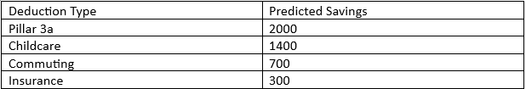
Personalized deduction recommendation
This gives a numeric estimate for each deduction’s benefit.

Slide 13
Quantile Regression Estimation
Goal: Provide a range, not just one number — e.g., “Your tax will be between CHF 21,900–25,200.”
The app will be fed with data that will serve as a base for the quantile regression. In the end, the newly entered data will also be added to the old list in order to improve the outcome. Thus, it will result in a dynamic model, that will give more accurate predictions as the number of users grows.
The regression will estimate the 10%, 50% and 90%, with 50% being the basic calculator's result.
The model is great for dealing with uncertainty by providing dynamic, non-static data.

Slide 14
Quantile Regression Estimation
Goal:
Provide a range, not just one number — e.g., “Your tax will be between CHF 21,900–25,200.”
The model deals with uncertainty by providing dynamic, non-static data.

Slide 15
Quantile Regression Estimation
90% quantile: 24'100
50% quantile: 21'000
10% quantile: 18'000

Slide 16
Visualisation
Pie-chart of Income tax: showcase the taxable income in different categories and visualize the %.
Pie-chart: taxable income vs remaining income

